Slide 1
Variable Elimination Method
Inference Operators:
Function or Factor, Multiplication or Product, Sum-out, Max-out
Given a set of variables Y, a function or a factor (Y) is a mapping from
all possible assignments to Y to a positive real number. We will refer to Y
as the scope of the function.

Slide 2
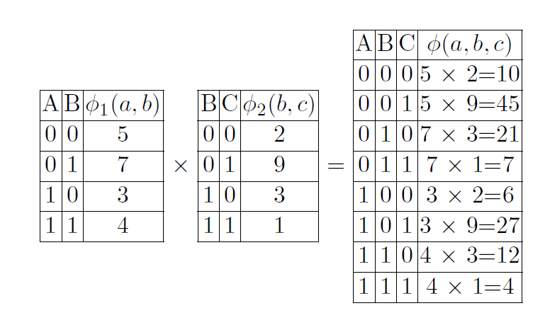
The product of two functions φ(A,B) and φ(B,C) is a function φ(A,B,C)

Slide 3
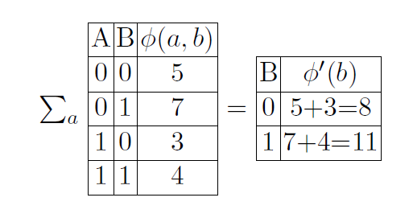
Summing out A from function φ(A,B) yields a function φ’(B) given below:

Slide 4
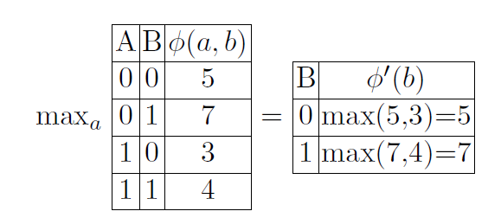
Maxing out A from function φ(A,B) yields a function φ ′(B) given below:

Slide 5
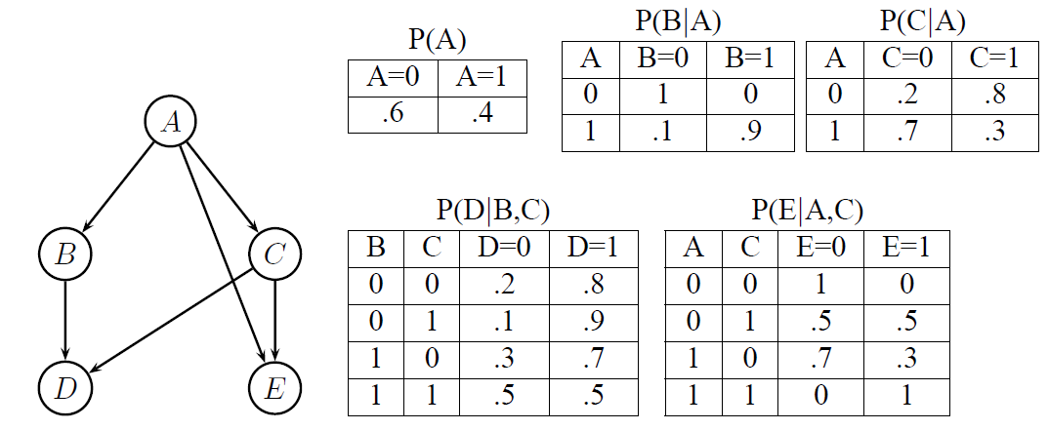
Example:

Slide 6
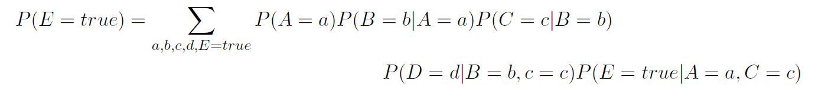
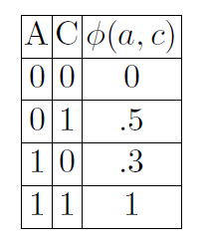
Let E = true be evidence. By definition,
(1)
Since E is already assigned a value, we can rewrite the CPT P(E|A,C)
as:
Rewriting Equation (1) using φ, we get

Slide 7

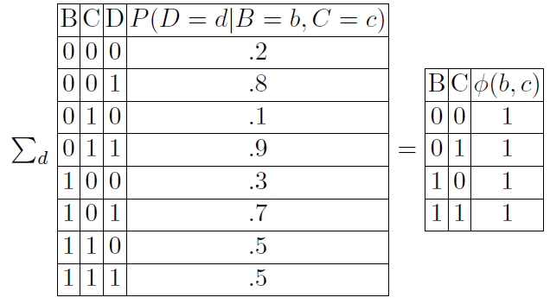
Distributing sums over products along the order (A,B,C,D), we get
Summing out D from P(D = d|B = b, c = c) yields a function φ(B,C) defined over B and C.

Slide 8
